Slide 1

YOUR NAME
Field Underwriter/Case Manager
National Producer Number: XXXXXXX
Resident State License ID: XXXXXXX STATE

Slide 2
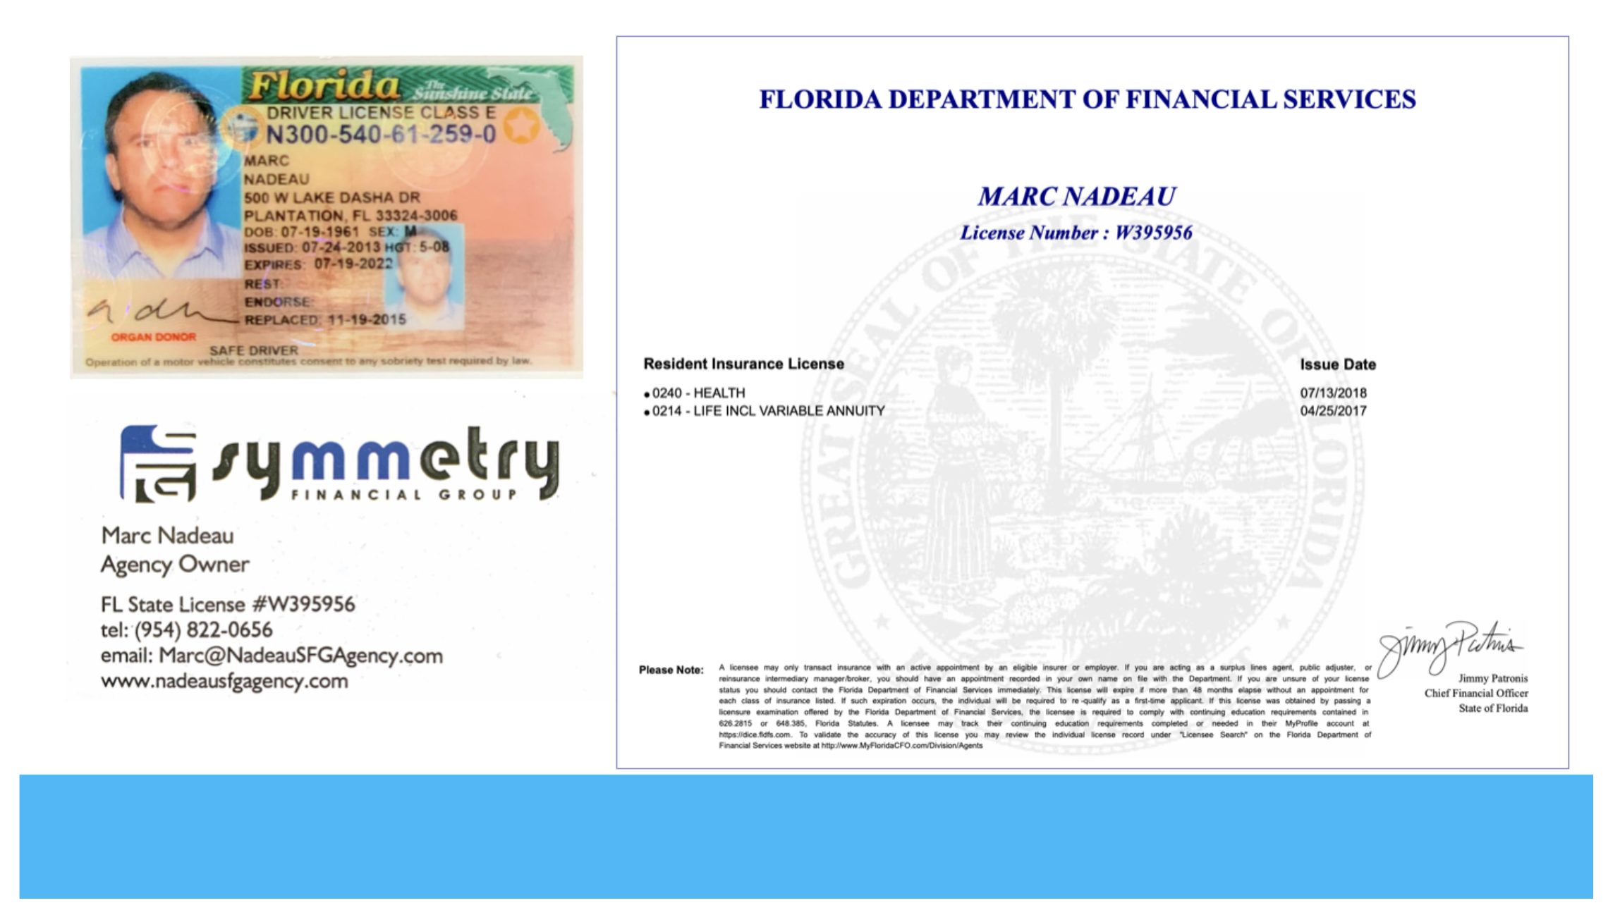
INSERT PHOTO OF LICENSE, DRIVERS LICENSE AND BUSINESS CARD
Example, delete this and
insert your full slide picture>>

Slide 3
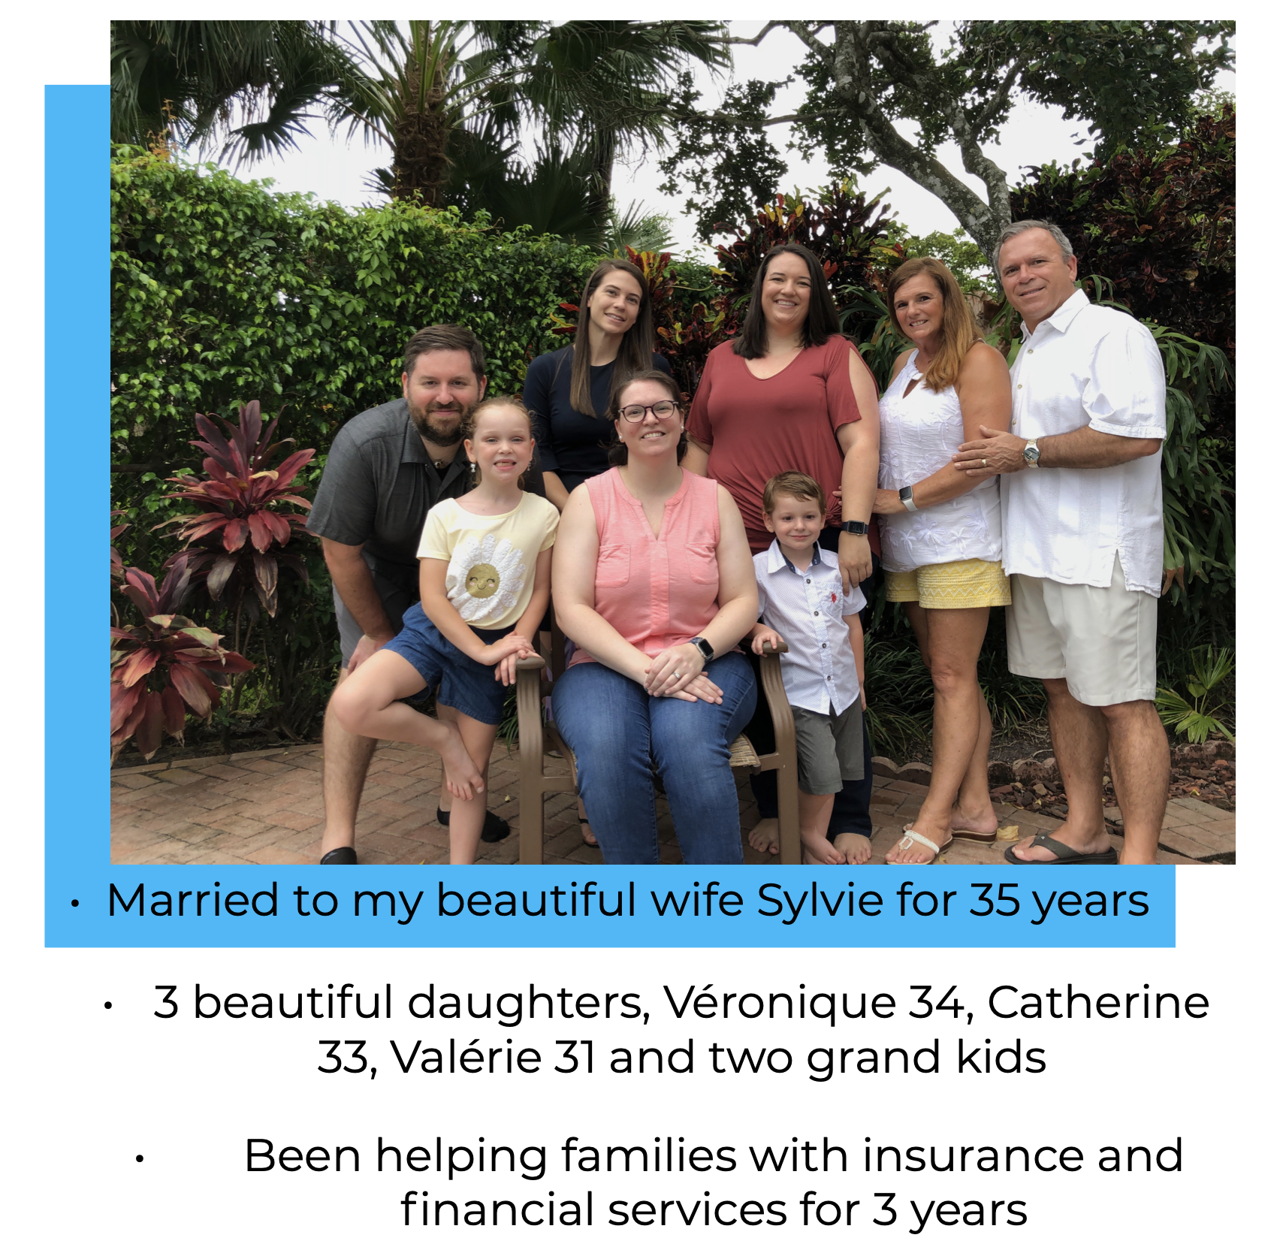
INSERT PHOTO OF FAMILY - A bit about you
Example, delete this picture
and insert your full slide picture>>

Slide 4
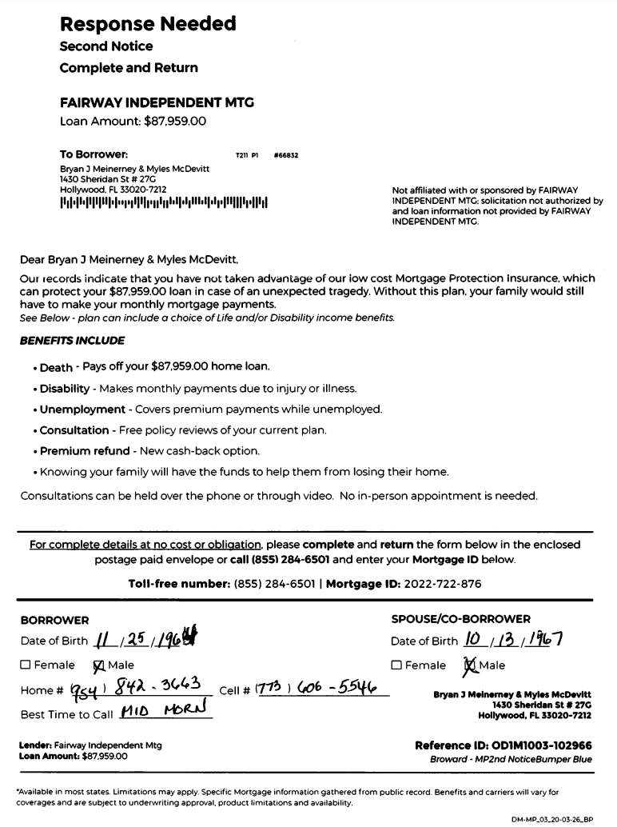
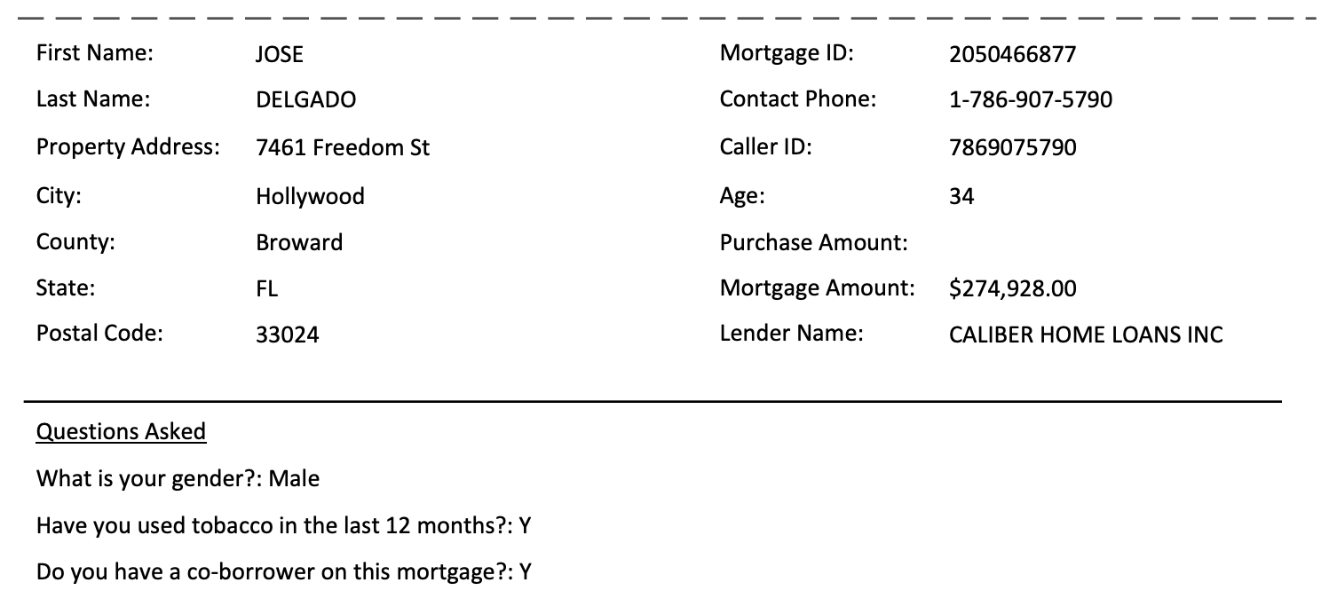
PUT PICTURE OF LEAD HERE (examples below)
OR
Delete this slide

Slide 5





Slide 6

4 Key Things
To Cover Today
My Role & Purpose: (You Cannot Buy Insurance Today)
1. Health Conditions & Medications
See How You Are Set Up In Your Home
3. Review Most Affordable Solutions
4. Help You Submit an Application Today

Slide 7
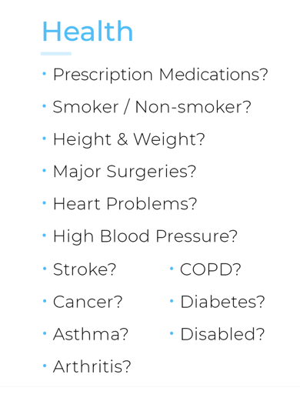
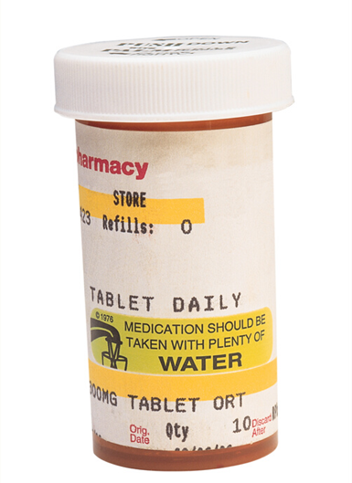
Verifying Information
Lifestyle
Occupation
License Suspensions?
Retired?
Speeding Tickets?
Working?
DUI/DWI?
Disability?
Felony/Parole/Probation?
Tests?
COVID?

Slide 8
Equity Appreciation
20 years
Home Value Goes Up. ->
15 years
Difference = Equity
*Commonly the largest asset*
Now
10 years
Mortgage Amount Owed Goes Down ->

Slide 9
Your Situation
Home Value:
Mortgage:
Equity:
Major Bills
Mortgage
Association
Utilities
(electric, water, gas)
Internet/cable
Car(s)
Insurance
(auto, life, health)
Cell phone(s)
Groceries
Eating Out
Kids Expenses
Credit Card Debt
Student Loans
Resources:
Existing Insurance-
Savings-
401K-
IRA-

Slide 10

What Would YOU Do?
90% of families are in jeopardy of losing their home
when a breadwinner passes.
If your spouse passed away yesterday, what would type of situation would that leave you in?
What would that look like for other family members/ children? (schools, sports teams, friends, etc?)
Would you stay in your home or move?
If you want to stay in your home, can you afford to?
If you want to move, where would you go: rent, move in with family, buy another home?

Slide 11
Know Your Options
Full Payoff
$200k
Pays off the full amount of mortgage
Harder to qualify for as we age and/or develop health issues
Partial Payoff
$100k
$200k
  Part of mortgage in policy
  Part of mortgage in accident only
  More affordable option
*Pays if
Accident
Death
6
12
18
24
Equity Protection & Critical Period
  Pays 6, 12, 18 or 24 months of mortgage payments
  Most popular option for those over 65 years old
  Psychologists say not to make any major decision for at least 12-24 months in the grieving process.
Time in Months to:
Grieve
Plan

Slide 12
Options Available To You:
includes for free:
chronic illness
terminal illness
critical illness
accidental
 | Mary | John
15 year | 58.50 | 63.72
20 year | 68.25 | 72.51
30 Year | xxx.xx | xxx.xx
OPTION #1
Partial Mortgage $65,000
Delete/Edit
for each client
 | Mary | John
15 year | 58.50 | 63.72
20 year | 68.25 | 72.51
30 Year | xxx.xx | xxx.xx
Delete if not
applicable
OPTION: #2
Full Mortgage
$130,000
Delete if not
applicable
 | Mary | John
30 year | xxx.xx | xxx.xx
30 year | 123.00 | 150.00
OPTION: #3
Full Mortgage -Cash Back
Half Mortgage- Cash Back
$130,000
$xx,xxx Cash Back
$xx,xxx Cash Back
$65,000

Slide 13
Options Available To You:
OPTION: A
$150,000
$$$
Full Mortgage Payoff Plan
Adjust # of
months
Middle price should
be about 10% of
monthly mortgage
payment
6 months mortgage payments
9 months mortgage payments
12 months mortgage payments
59.53
OPTION: B
Mortgage Payment Plan
87.40
115.26
6 months mortgage payments
9 months mortgage payments
12 months mortgage payments
89.53
OPTION: C
Mortgage Payment Plan with
Full payoff if accidental death
117.40
145.26

Slide 14
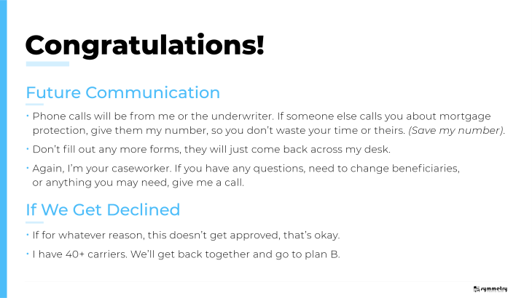

Slide 15


