Slide 1
FIRST NAME LAST NAME
Agency Name
National Producer Number: XXXXXXX
Resident State License ID: XXXXXXX STATE

Slide 2
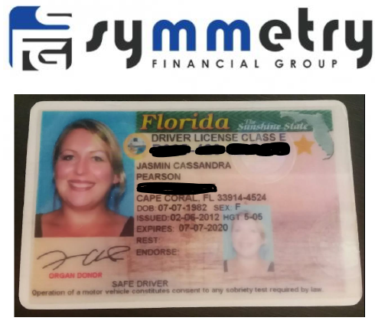
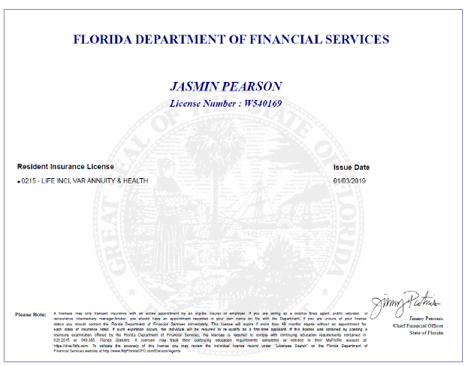
Who am I
Cell Phone: 239.464.4550
Email: jp.symmetryfinancial@gmail.com

Slide 5
4 Key Things To Cover Today
My Role & Purpose: (You Cannot Buy Insurance Today)
1. Health Conditions & Medications
See How You Are Set Up In Your Home
3. Review Most Affordable Solutions
4. Help You Submit an Application Today

Slide 6
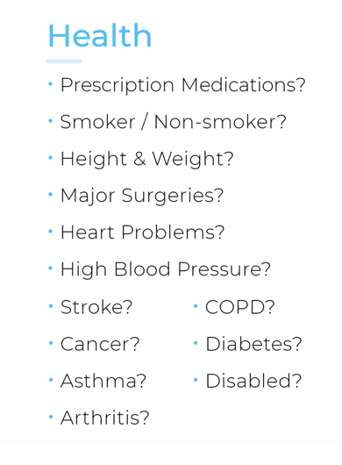
Verifying Information
Lifestyle
Occupation
License Suspensions?
Retired?
Speeding Tickets?
Working?
DUI/DWI?
Felony/Parole/Probation?
Tests?

Slide 7
3 Ways to do Protection
FULL
Pays off the full amount of mortgage
Harder to qualify for as we age and/or develop health issues
PARTIAL
Part of Mortgage Payment 50/50
Part coverage in accidental
More affordable solution
CRITICAL PERIOD & EQUITY PROTECTION
Pays 6, 12, 18, 24 months of mortgage payments
Most popular after 65, or when surviving spouse will move
Psychologists say not to make big decisions for at least 12 months during the grieving process
Gives time to put house on the market, pack, find a new house, and sell the house to get equity

Slide 9
How it works, when you put in an application, one of four things can happen.
APPROVED AS APPLIED - We put it in, and they issue it as applied for.
APPROVED BELOW - They can also say "Yeah, we will approve you, but we found a couple things in the underwriting
so we're going to change the Risk Rate / Premium increase
or we’ll have to offer a different product.
3. DECLINE “thanks, but no thanks, too risky, we're not doing it, we're declining it”.
We're obviously trying to avoid.

Slide 10
